Slide 1
Hello
Konnichiwa

Slide 2
OKINAWA
Hotel Management System (Group II)

Slide 3
OUTLINES
Requirements
Team Role Assignments
Development Schedule
Risk Identification
Team Conflicts and Communication
Benefits

Slide 4
Requirements
Reading and Doing Analysis on Given Requirements

Slide 5



?
(5) Main Functions
Reservation
Cancellation
Inquiry
Check
Hotel Information
Added Functions
Update

Slide 6
Roles
Assigning Roles to Each Member of the Team

Slide 7


DOCS
Documentation
Program Coding
CODING
Class Diagram
ER Diagram
Sequence Diagram
Interface Design
Screen Transition
Use Case
Class Specification
Class Diagram
ER Diagram
Sequence Diagram
Interface Design
Screen Transition
Use Case
Class Specification

Slide 8
Dev. Schedule
Planning and Making Schedule for Project

Slide 9
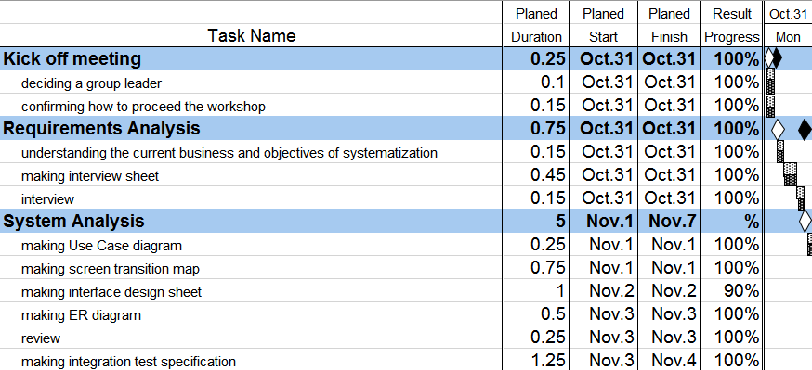

DEVELOPMENT SCHEDULE
Planning of which Tests should be Done on which Days
CLICK ME

Slide 10
Risks
Identifying Risks and How We Overcome Those Risks

Slide 11
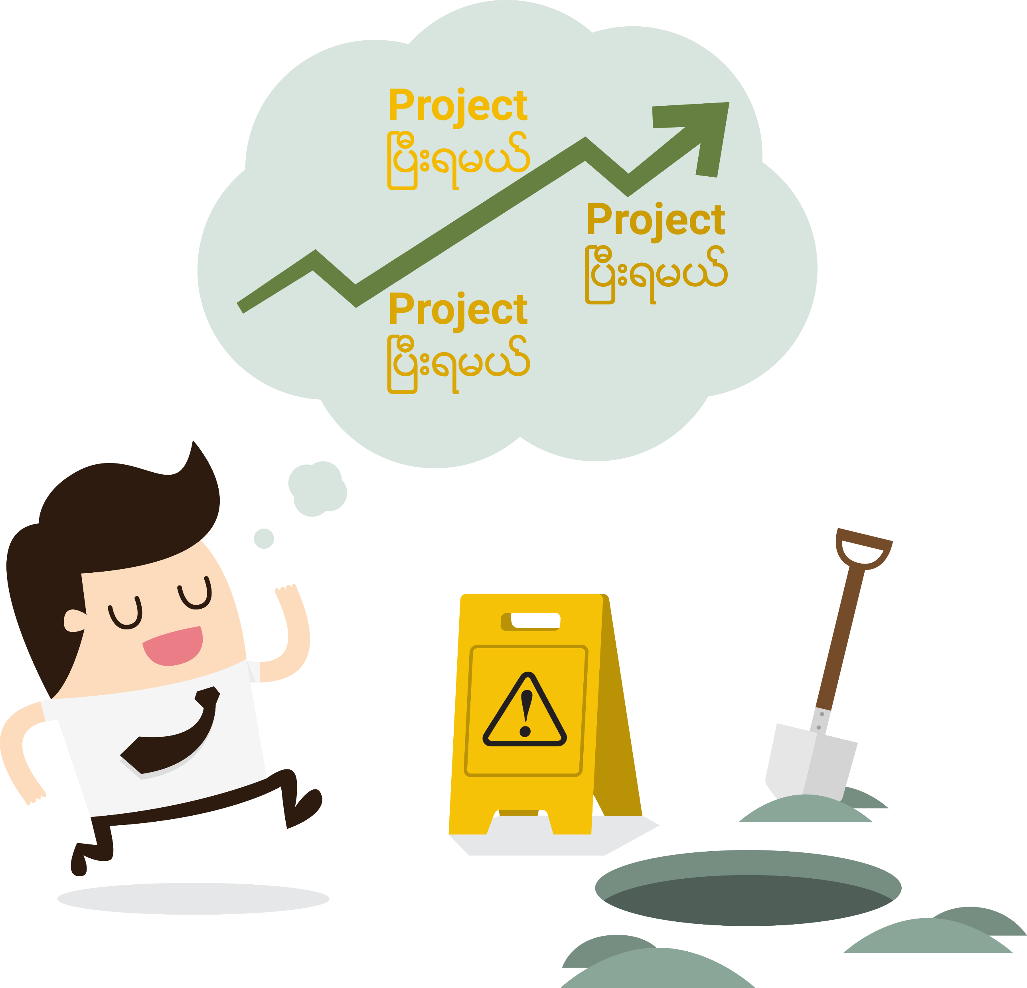
TEAM
STRESS
PC PROBLEMS
PROGRAM ERRORS
HUMAN FAULT
RISKS

Slide 12
Team
How we communicate and solve conflicts in the Team

Slide 13

COMMUNICATION

Slide 14

CONFLICTS

Slide 15
Benefits
What we got from this workshop

Slide 16

BENEFITS
How VCS is Important
Why Docs are Important
How to work with Team
Experience

Slide 17
One More Slide
No more description, Just Move to Next Slide

Slide 18

THE END

Slide 19

Thanks
Arigatou
https://github.com/yzhtun23/Okinawa_HMS

